Slide 1
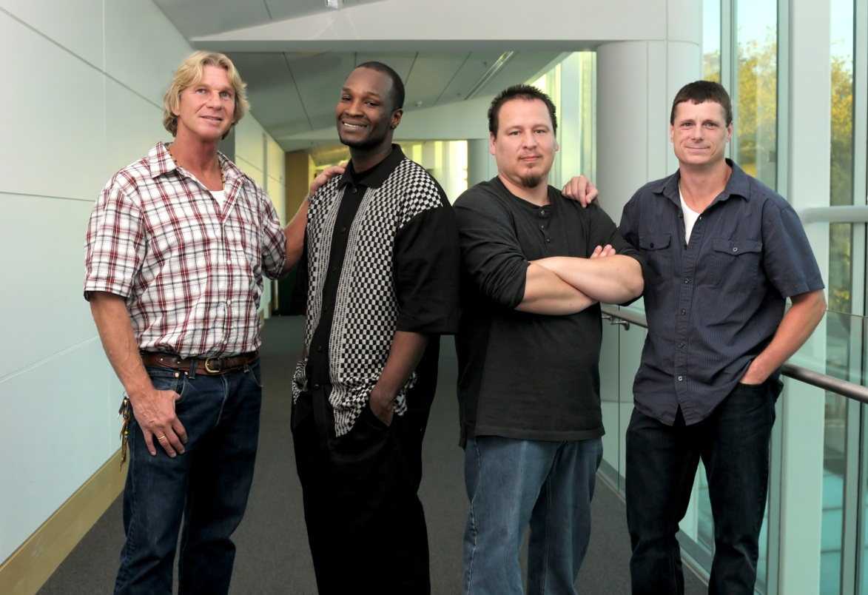
The Innocence Project Northwest
Professor Jackie McMurtrie
March 1, 2012

Slide 2
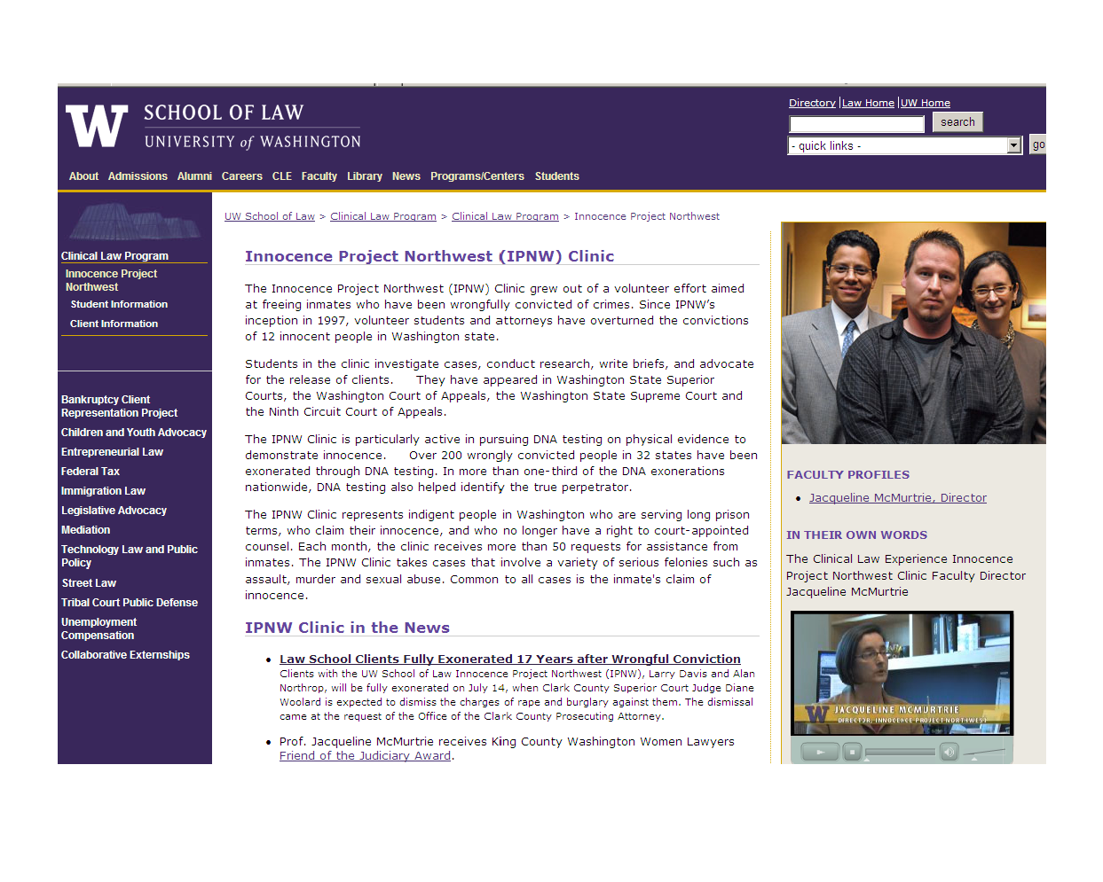
Innocence Project NW Clinic

Slide 3
Wrongful Convictions
The Innocence Project
  289 inmates released through DNA testing.
National Registry of Exonerations
  850 exonerations from 1989 to present.
Innocence Project Northwest
  15 convictions overturned since 1997.

Slide 4
Factors Leading to Conviction of the Innocent
Mistaken eyewitness identification.
Coerced confessions.
Unreliable forensic laboratory work.
Police misconduct.
Prosecutorial Misconduct.
Ineffective representation by Counsel.

Slide 5
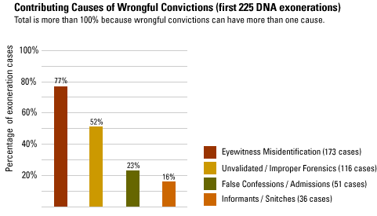
*
* The Innocence Project: Understand the Causes http://innocenceproject.org/understand/

Slide 6
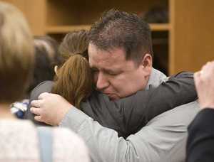
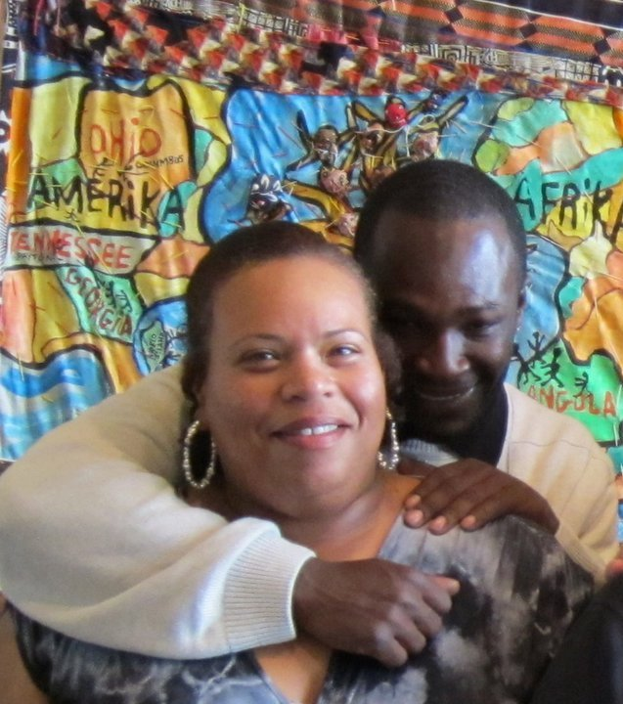
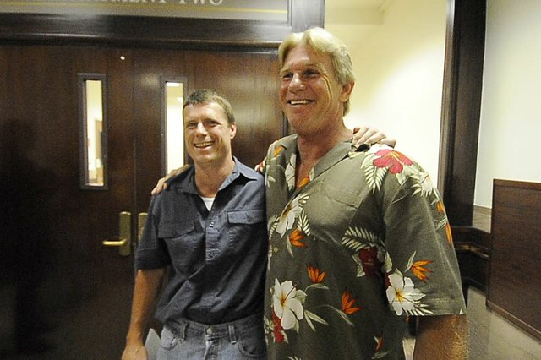
Ted Bradford
James Anderson
Alan Northrop & Larry Davis

Slide 7
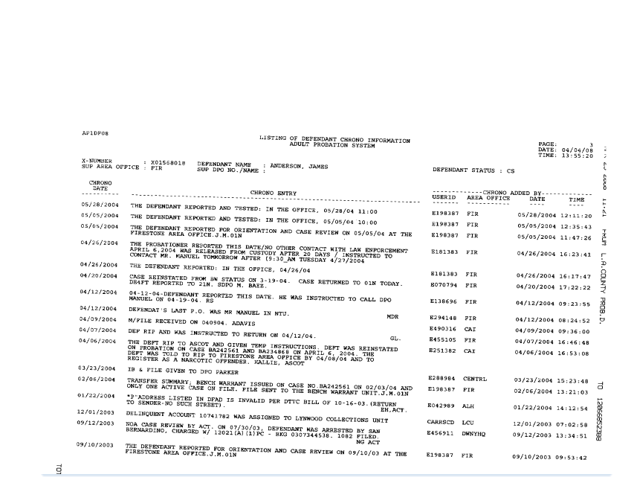
James Anderson: 2007 to 2008
James Anderson: 2004 to 2008
Probation Record

Slide 8
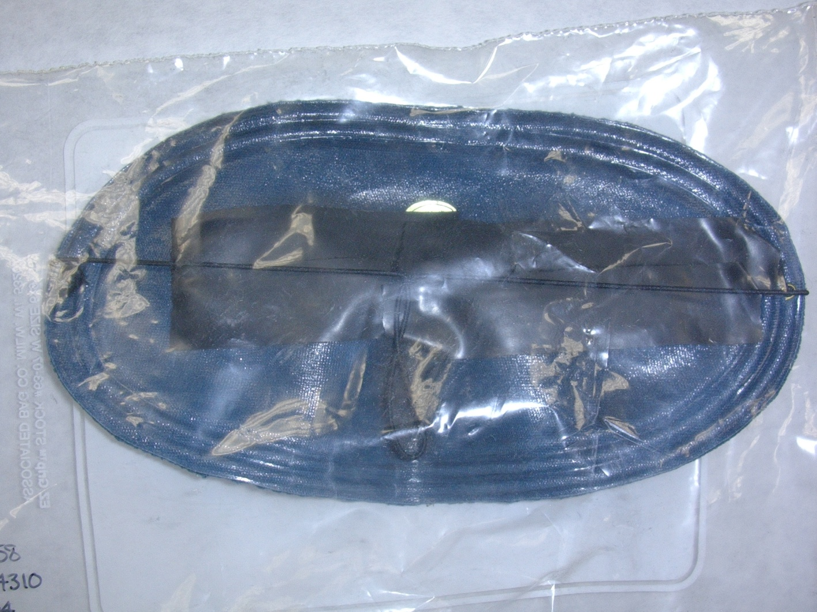
Ted Bradford: 1995 to 2010

Slide 9
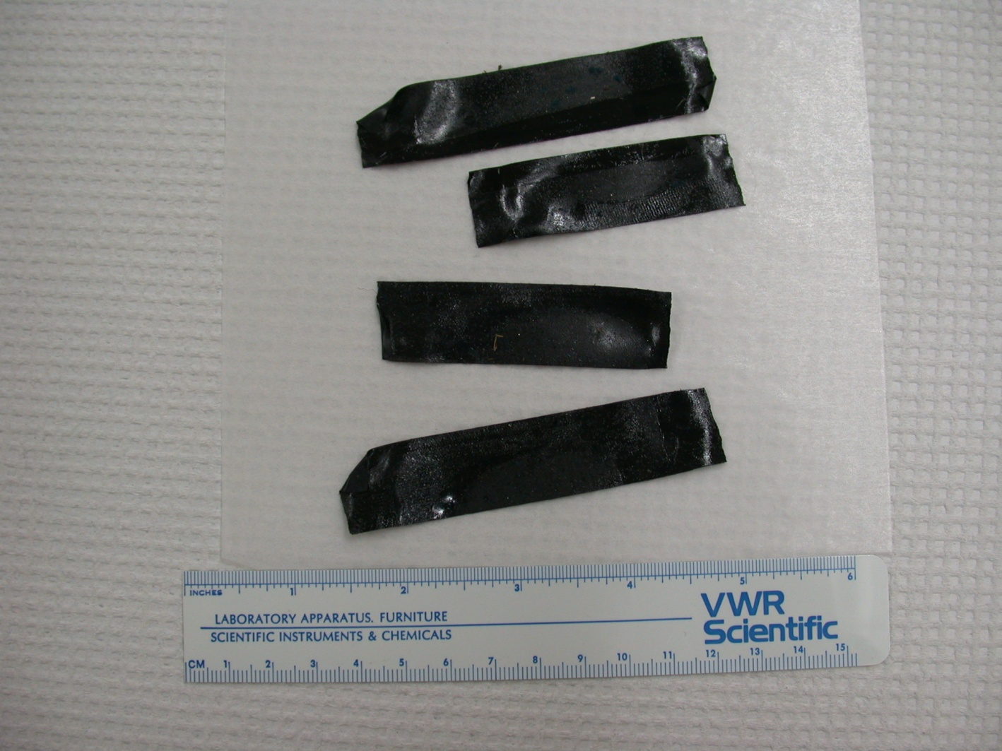

Slide 10
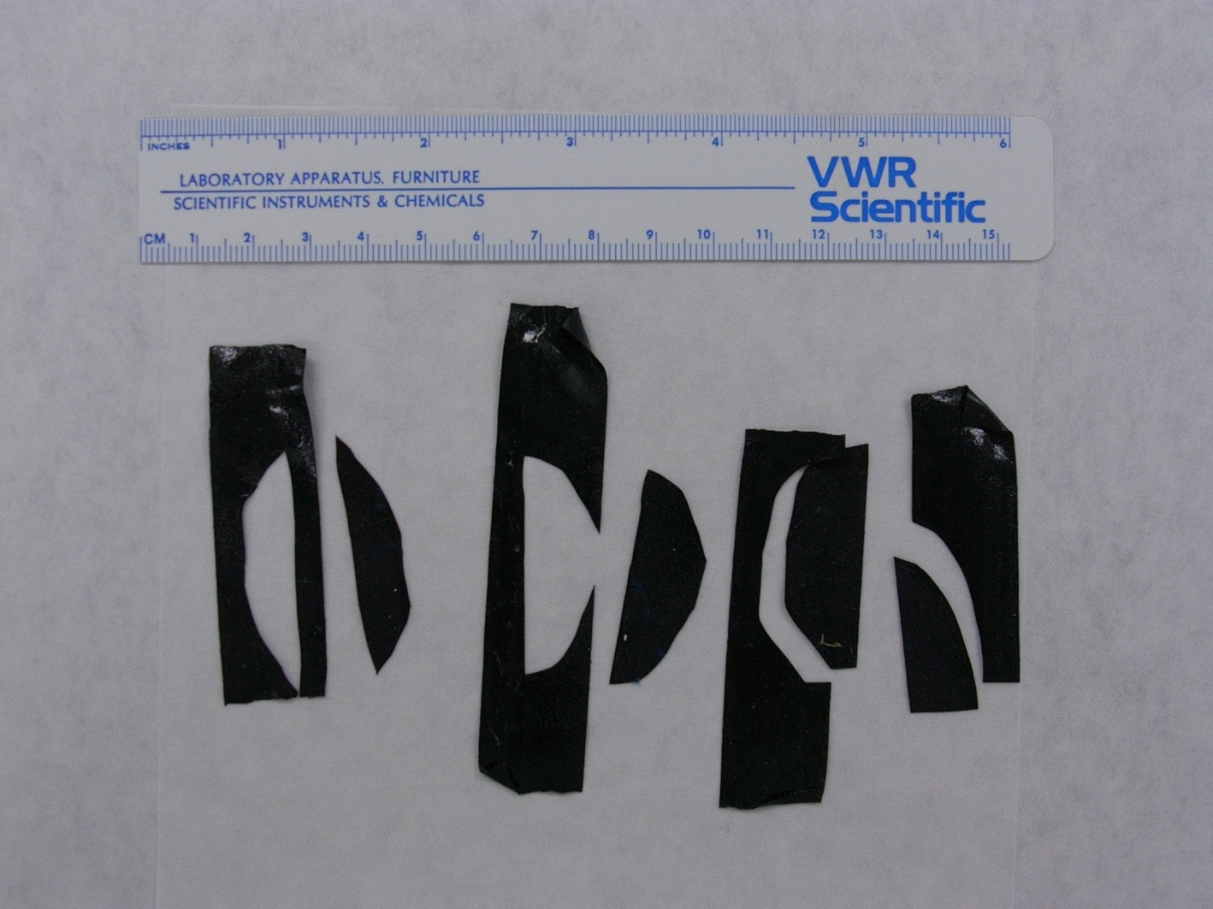

Slide 11
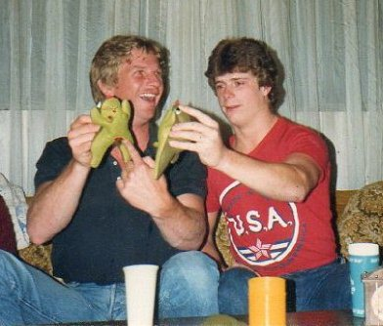
Larry Davis &
Alan Northrop: 1993 to 2010
1993

Slide 12
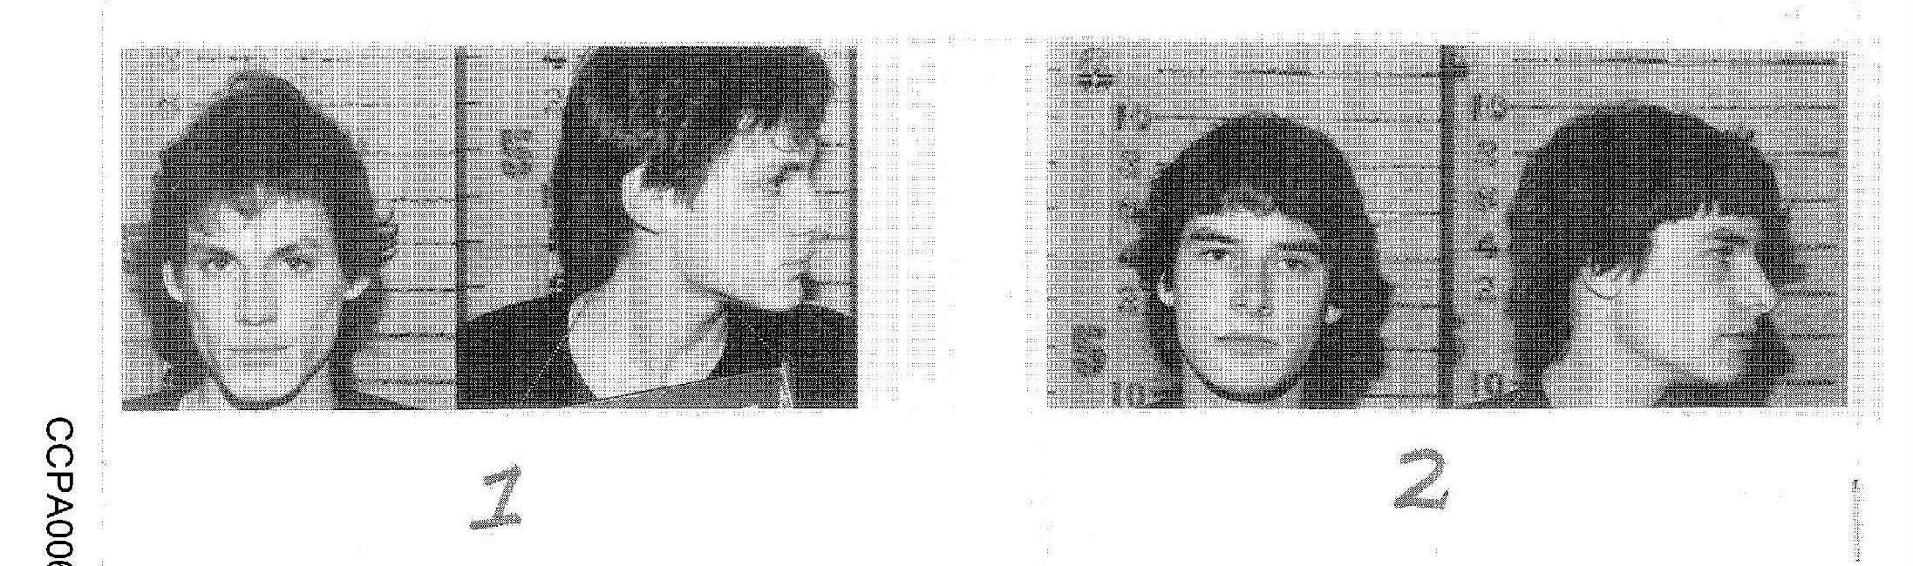
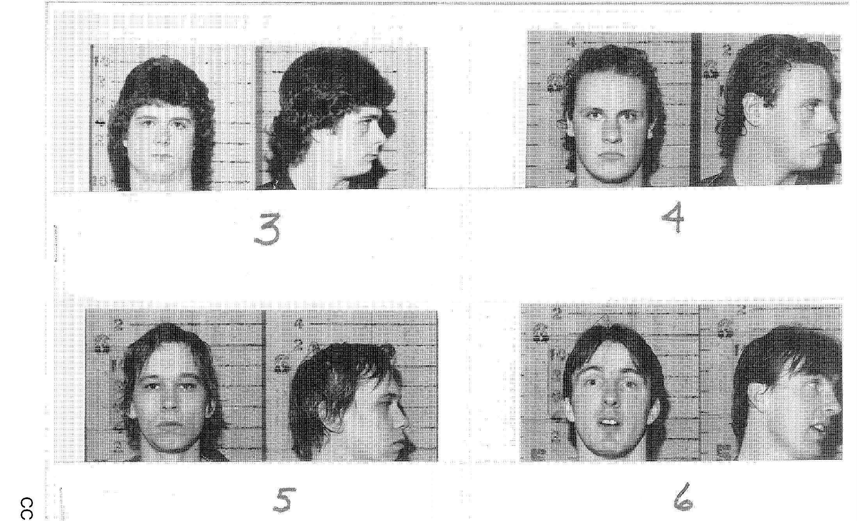
Larry Davis &
Alan Northrop – 2002 - 2010

Slide 13
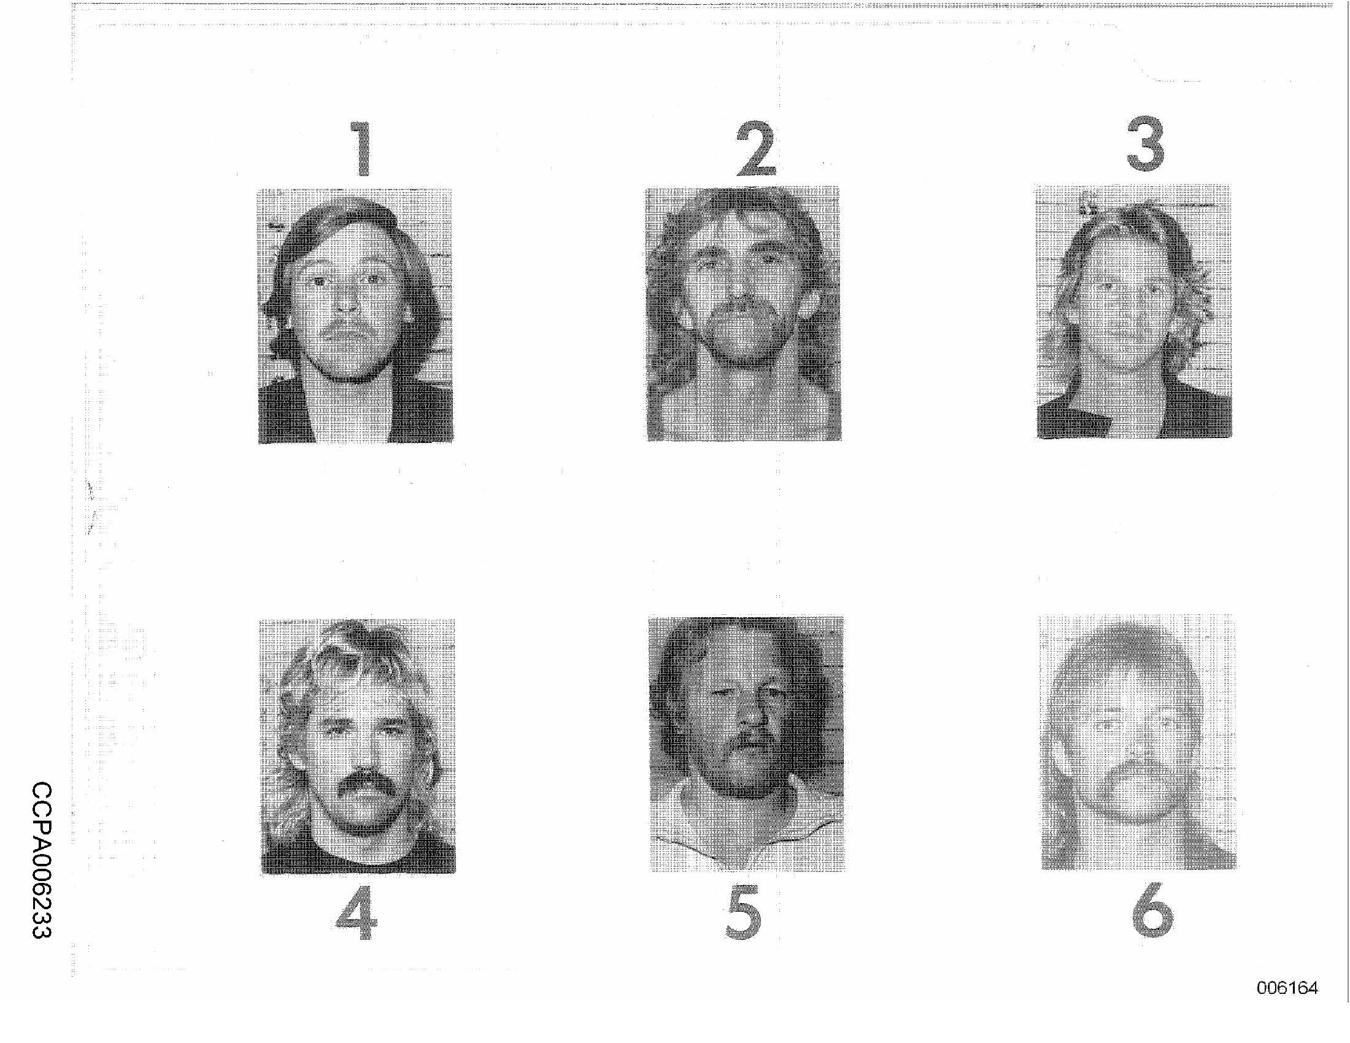
Larry Davis &
Alan Northrop – 2002 - 2010

Slide 14
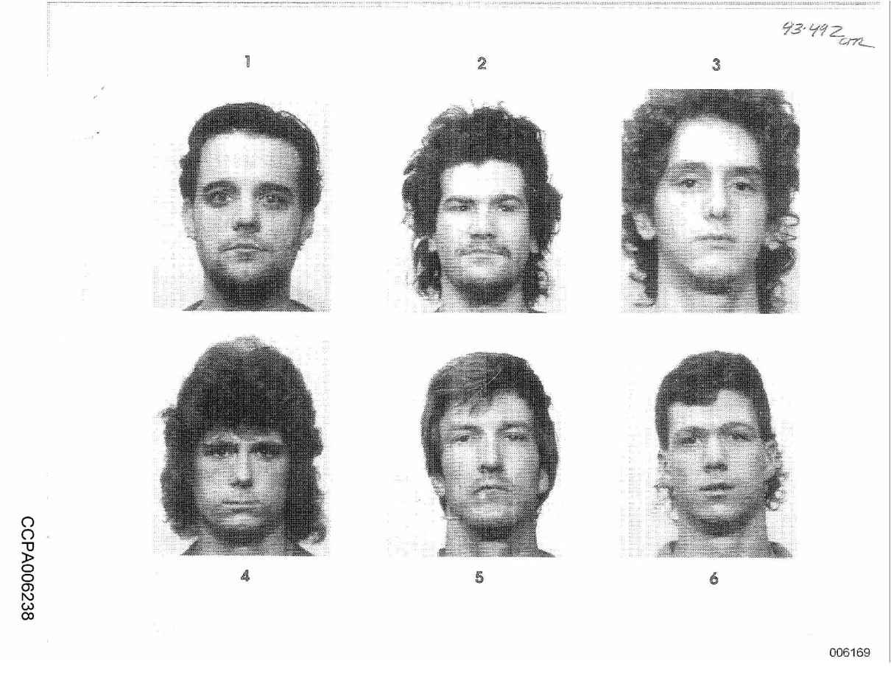

Slide 15
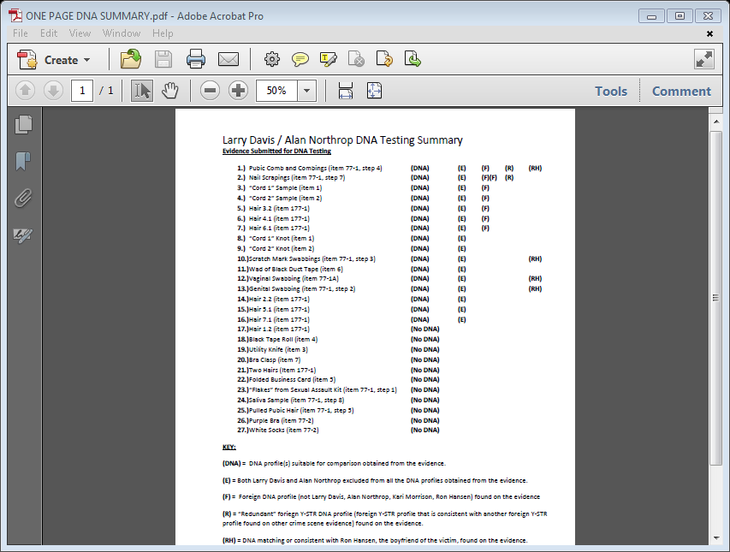
Larry Davis &
Alan Northrop – 2002 - 2010
Larry Davis and Alan Northrop: DNA Summary
ONE PAGE DNA SUMMARY.pdf

Slide 16
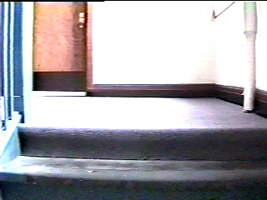
Event Lineup

Slide 17
1
2
3
4
5
6

Slide 18
Reforms to Protect the Innocent
Mistaken eyewitness identification.
  “Double-blind” identification procedures.
    Positive feedback distorts confidence and reinforces false identification.*
* Bradfield, Wells & Olson, The Damaging Effect of Confirming Feedback on the Relation Between Eyewitness Certainty and Identification Accuracy, 87 J.Applied Psychol. 112-120 (2002).

Slide 19
1
2
3
4
5
6

Slide 20
Reforms to Protect the Innocent
Mistaken eyewitness identification.
  “Double-blind” lineups
    Positive feedback distorts confidence and reinforces false identification
  Sequential, rather than simultaneous lineups*
    Relative Judgment
    *Gary L. Wells et al., Eyewitness Identification Procedures: Recommendations For Lineups and Photospreads, 22 Law & Hum. Behav. 603-647 (1998).

Slide 23
