Slide 1
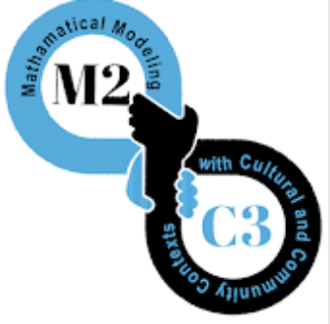

Making Math Meaningful for
Multilingual Learners
Julia Aguirre
University of Washington Tacoma
jaguirre@uw.edu
August 13, 2020
Project TELL:
ELL Supports and Mentoring Institute
Tacoma Public Schools
Tacoma, WA
EHR: #1561274

Slide 2
Welcome! Introduce yourself in the Chat
Name, role, grade level/school, district

Slide 3
Math is meaningful when
students are… teachers are…
Notes:
https://www.theresawills.com/templates
Type in the text box

Slide 4
Math is meaningful when
students are… teachers are…
Notes:
https://www.theresawills.com/templates
Type in the text box

Slide 5
Session Overview
Exploring our vision for Meaningful Math
Mathematizing the World: Routine & Task ideas
Connecting with families & communities

Slide 6
Strategies that support math learning for multilingual students
Provide relevant contexts**: Connect math to student’s life experiences and cultural & community-based funds of knowledge
Create language rich environment: visual posters of student work, reference charts, multiple voices in multiple languages
Establish communication norms: Students explain, justify, summarize, question and share solutions
Adapted from Anhalt (2014)
Notes:
Look for these strategies throughout the presentation

Slide 7

Mathematizing the World:
Routines & Tasks

Slide 8
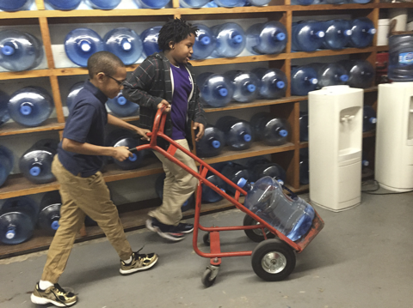
What do you notice?
What do you wonder?
What questions can be answered with mathematics?
https://www.npr.org/2016/03/16/470512927/before-flint-lead-contaminated-water-plagued-schools-across-u-s
Notes:
Unmute or write in chat box: What do you notice?

Slide 9
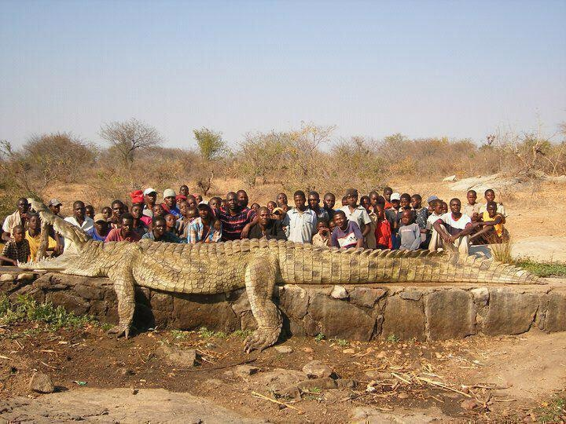
What do you notice? What do you wonder?
Notes:
Unmute your mic or put in the chat:

Slide 10
What questions can you answer using math?
Notes:
Unmute your mic or put in the chat:

Slide 11
Mathematizing the world Routine:
What you select should have math and context features that “hook” student curiosity
Show an image, video, table or graph, a story, or object
  Ask:
    What do you notice?
    What do you wonder?
    What questions could you answer using mathematics?
Practice Observation
Practice Problem-posing
Practice Problem-posing with mathematics

Slide 12
Mathematizing the World Routine:
Problem-Posing with Mathematics
Pose a specific mathematical question related to image, photo or object
  Question can be posed by children or by the teacher
Discussion focuses on what one would do to answer the question:
  What do we know? What do we need to know?
  What can we do to figure this out?
  What assumptions or decisions will we have to make?

Slide 13
Notes:
This image was very popular across project sites

Slide 14
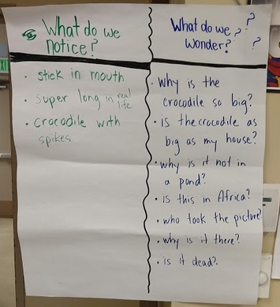
Rising 1st graders’ Noticings and
Wonderings about the Crocodile
McVicar (2019)

Slide 15
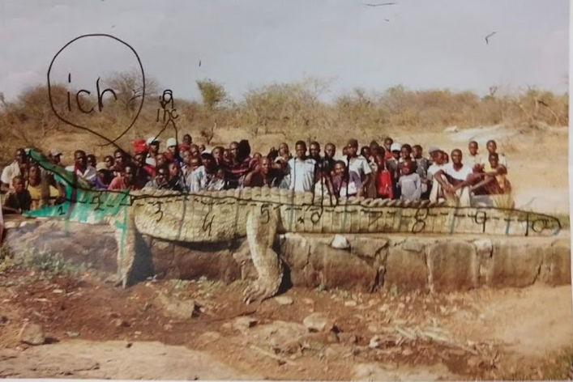
6 year old’s math thinking
measurement knowledge
McVicar (2019)
Notes:
Here’s one 1st grader’s work sample:
Mathematical funds of knowledge:
did not use a ruler, but has ideas about equal spacing (used scales!)
Measure from one length to another
Grappling with units: How long is an inch? An inch on a paper? Does one person equal an inch?
Exciting to see young kids engaging with mathematics, and draw on their funds of knowledge

Slide 16
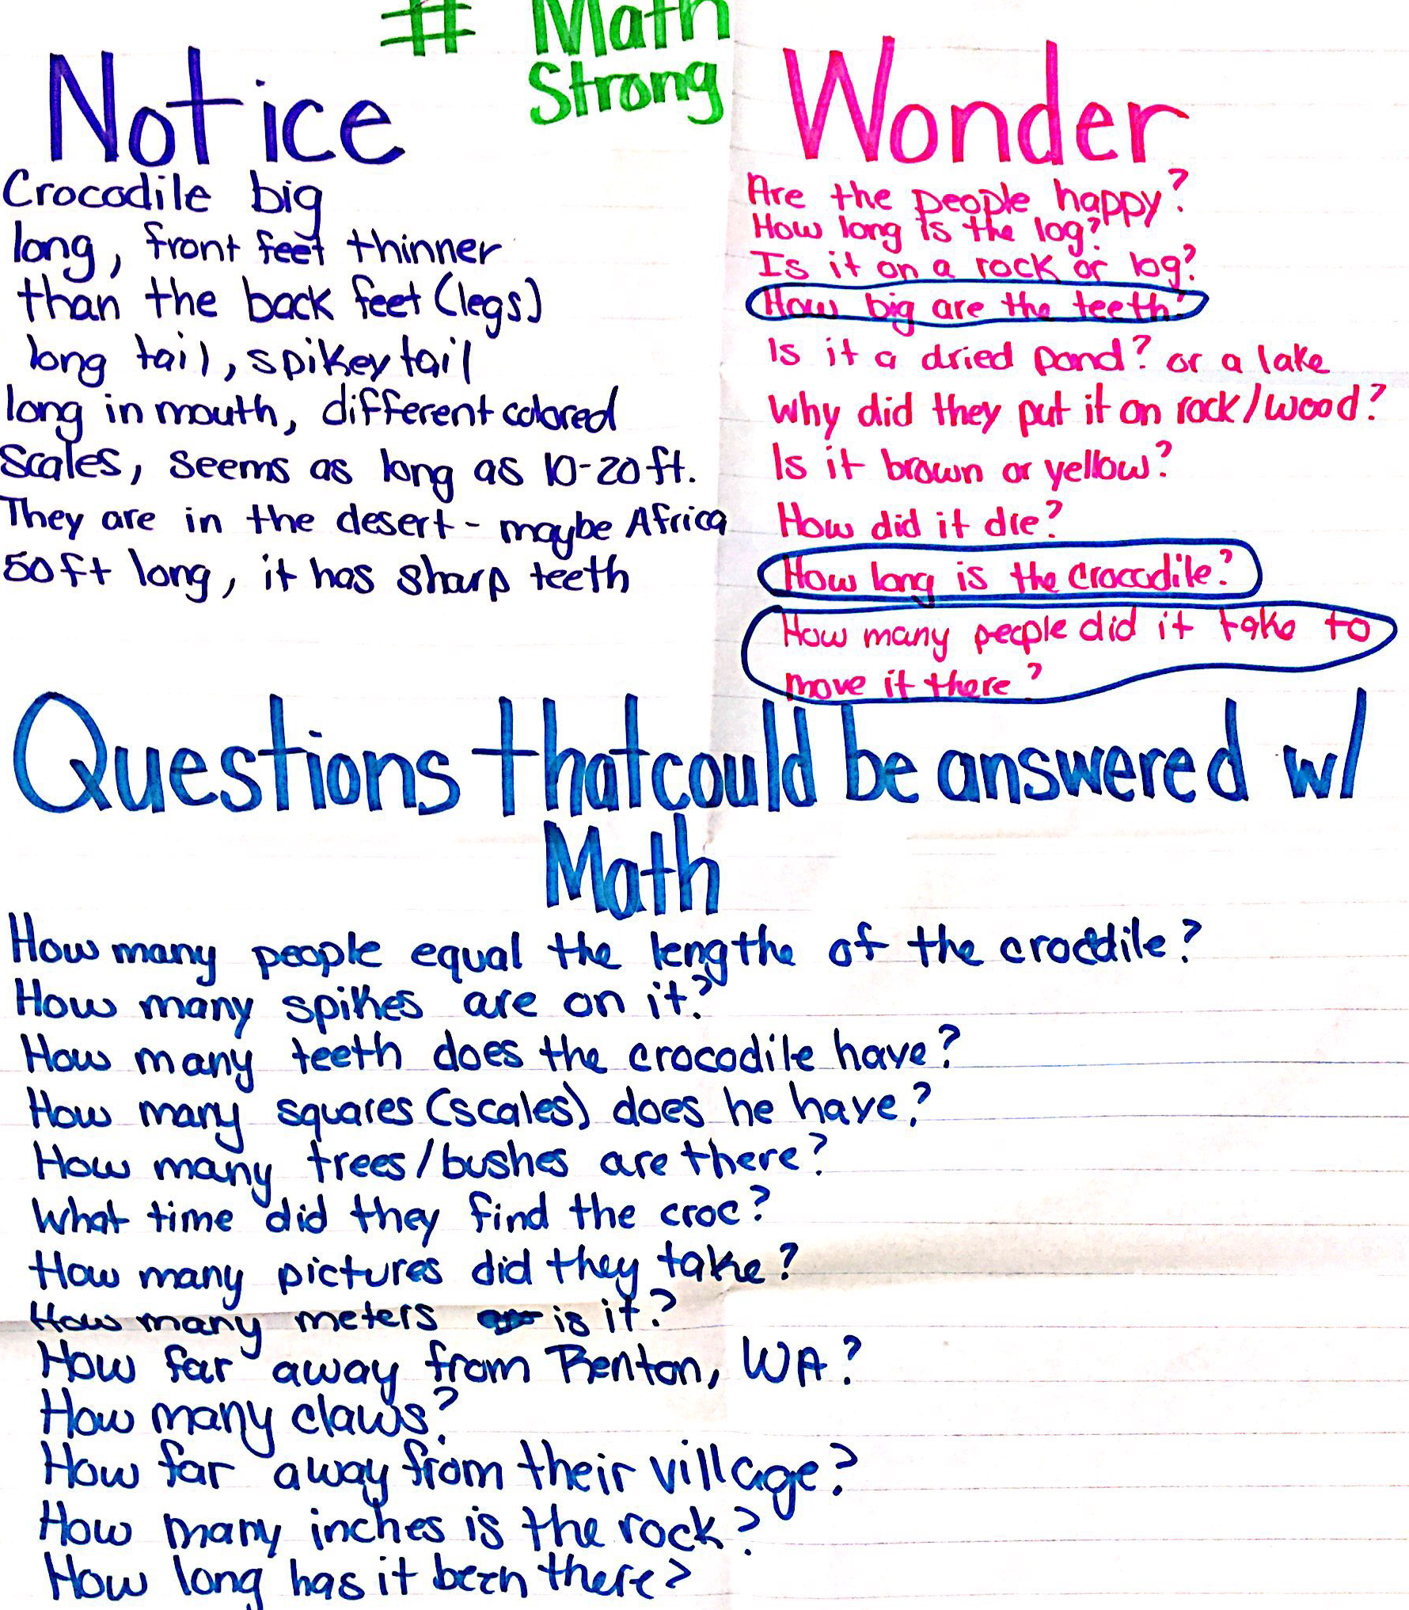
Grade 3 students’ Noticings and
Wonderings about the Crocodile
City, WA?

Slide 17
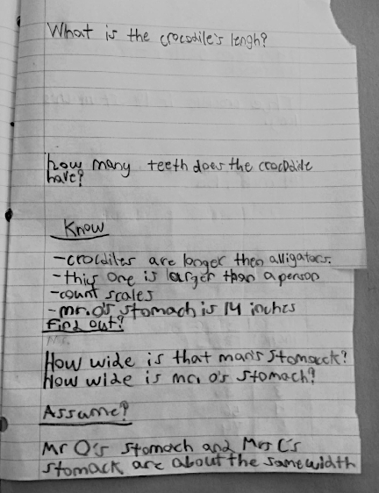
Question to answer using mathematics
What do we know: Mr. O’s (teacher’s) stomach is 14 inches wide.
What do we
need to know:
How wide is the man’s (in the picture) stomach?
We assume:
Mr. O’s stomach is about the same width as the man’s in the picture

Slide 18
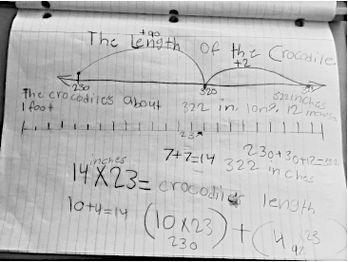
Students estimated that the man in the white shirt “fit” 23 times in the length of the crocodile.
If the man’s stomach was about 14 inches wide, then the length of the crocodile was about: 14 x 23 inches.
Notes:
Partitioning multiplication strategy 14 x 23 is the same as (10 x 23) + (4 x 23)
230 + 90 + 2 = 322 inches. No conversion to feet. Also represented with an open line graph to represent solution of how long is crocodile.

Slide 19
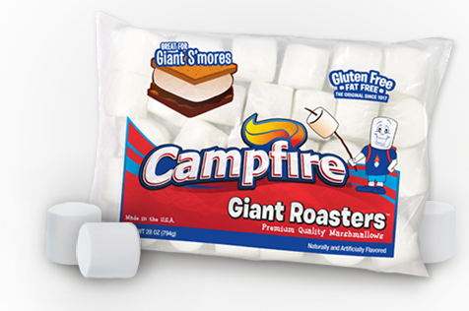
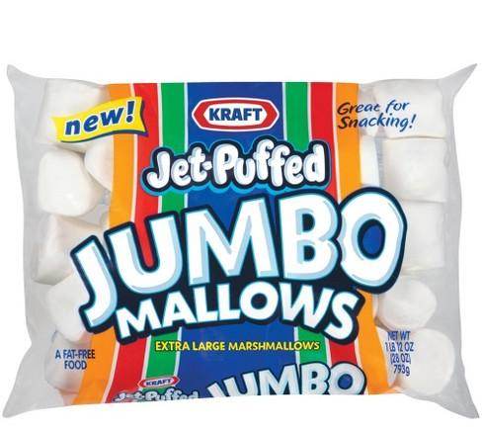
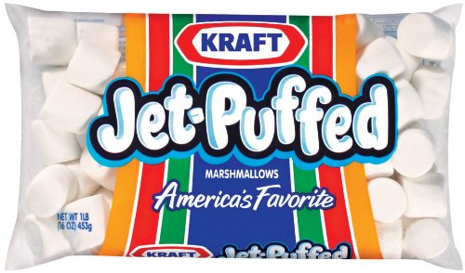
Bags of Marshmallows
What do you notice? What do you wonder?
Notes:
We started talking to kids about camping trips.
Naturally eat marshmallows
What do you notice/wonder about this image?

Slide 20
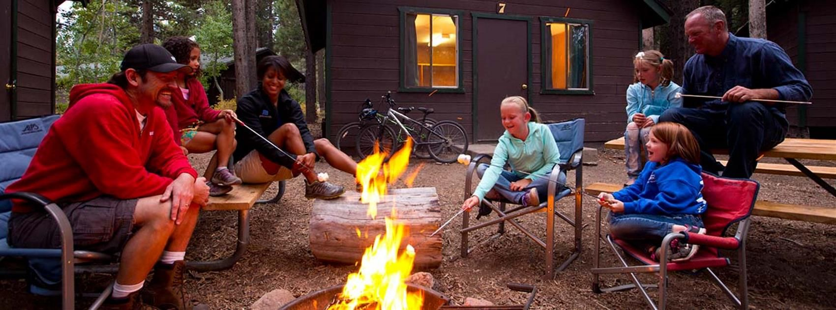
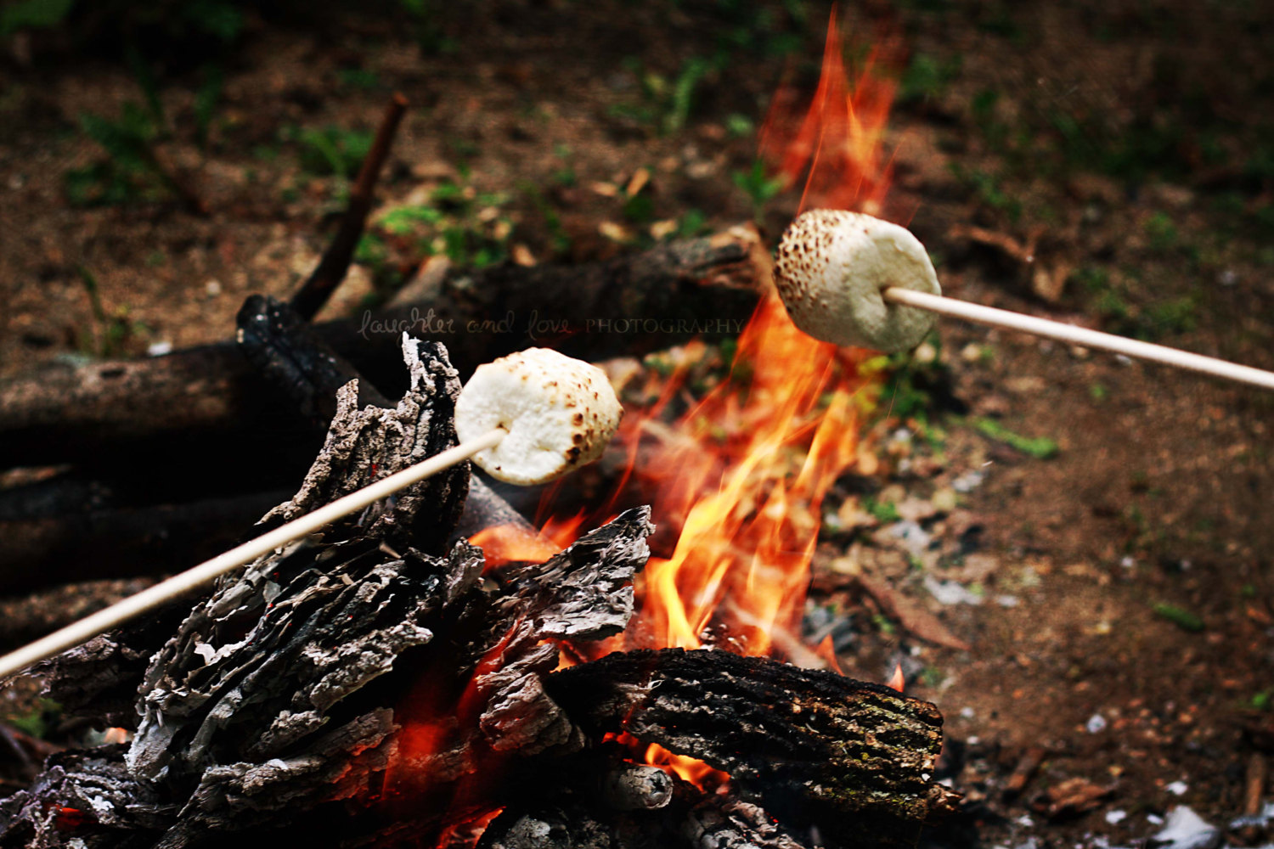
What questions could we answer using math?

Slide 21
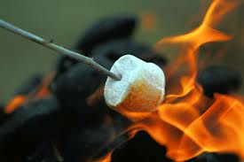
Marshmallows for the 4th grade camping trip
How many marshmallows do we need to buy for the class camping trip?
What do we know that can help us? | What do we need to know? How can we get that information? | What do we need to assume or decide?

Slide 22
Marshmallows for the 4th grade camping trip
https://sites.google.com/qc.cuny.edu/m2c3/home
How many marshmallows do we need to buy for the class camping trip?
Make a plan that would help the camp organizers to buy enough marshmallows with few leftovers.
PLAN CRITERIA
Use pictures, words and numbers to show your plan.
List your assumptions
Explain how your plan is fair
Explain how other groups could use your plan to figure out how many marshmallows they need for their camping trip.

Slide 23
Group 1
Notes:
Figure out: How many marshmallows do we need to buy for the class camping trip?
Make a plan that would help the camp organizers to buy enough marshmallows with few leftovers.
PLAN CRITERIA
Use pictures, words and numbers to show your plan.
List your assumptions
Explain how your plan is fair
Explain how other groups could use your plan to figure out how many marshmallows they need for their camping trip.

Slide 24
Group 2
Notes:
Figure out: How many marshmallows do we need to buy for the class camping trip?
Make a plan that would help the camp organizers to buy enough marshmallows with few leftovers.
PLAN CRITERIA
Use pictures, words and numbers to show your plan.
List your assumptions
Explain how your plan is fair
Explain how other groups could use your plan to figure out how many marshmallows they need for their camping trip.

Slide 25
Group 3
Notes:
Figure out: How many marshmallows do we need to buy for the class camping trip?
Make a plan that would help the camp organizers to buy enough marshmallows with few leftovers.
PLAN CRITERIA
Use pictures, words and numbers to show your plan.
List your assumptions
Explain how your plan is fair
Explain how other groups could use your plan to figure out how many marshmallows they need for their camping trip.

Slide 26
Group 4
Notes:
Figure out: How many marshmallows do we need to buy for the class camping trip?
Make a plan that would help the camp organizers to buy enough marshmallows with few leftovers.
PLAN CRITERIA
Use pictures, words and numbers to show your plan.
List your assumptions
Explain how your plan is fair
Explain how other groups could use your plan to figure out how many marshmallows they need for their camping trip.

Slide 27
Marshmallows for the
4th grade camping trip
How many marshmallows do we need to buy for the 4th grade camping trip?
Make a plan that would help the camp organizers to buy enough marshmallows with few leftovers.
PLAN CRITERIA
- Use pictures, words and numbers to show your plan.
- List your assumptions
- Explain how other groups could use your plan to figure out how many marshmallows they need for their camping trip.

Slide 28
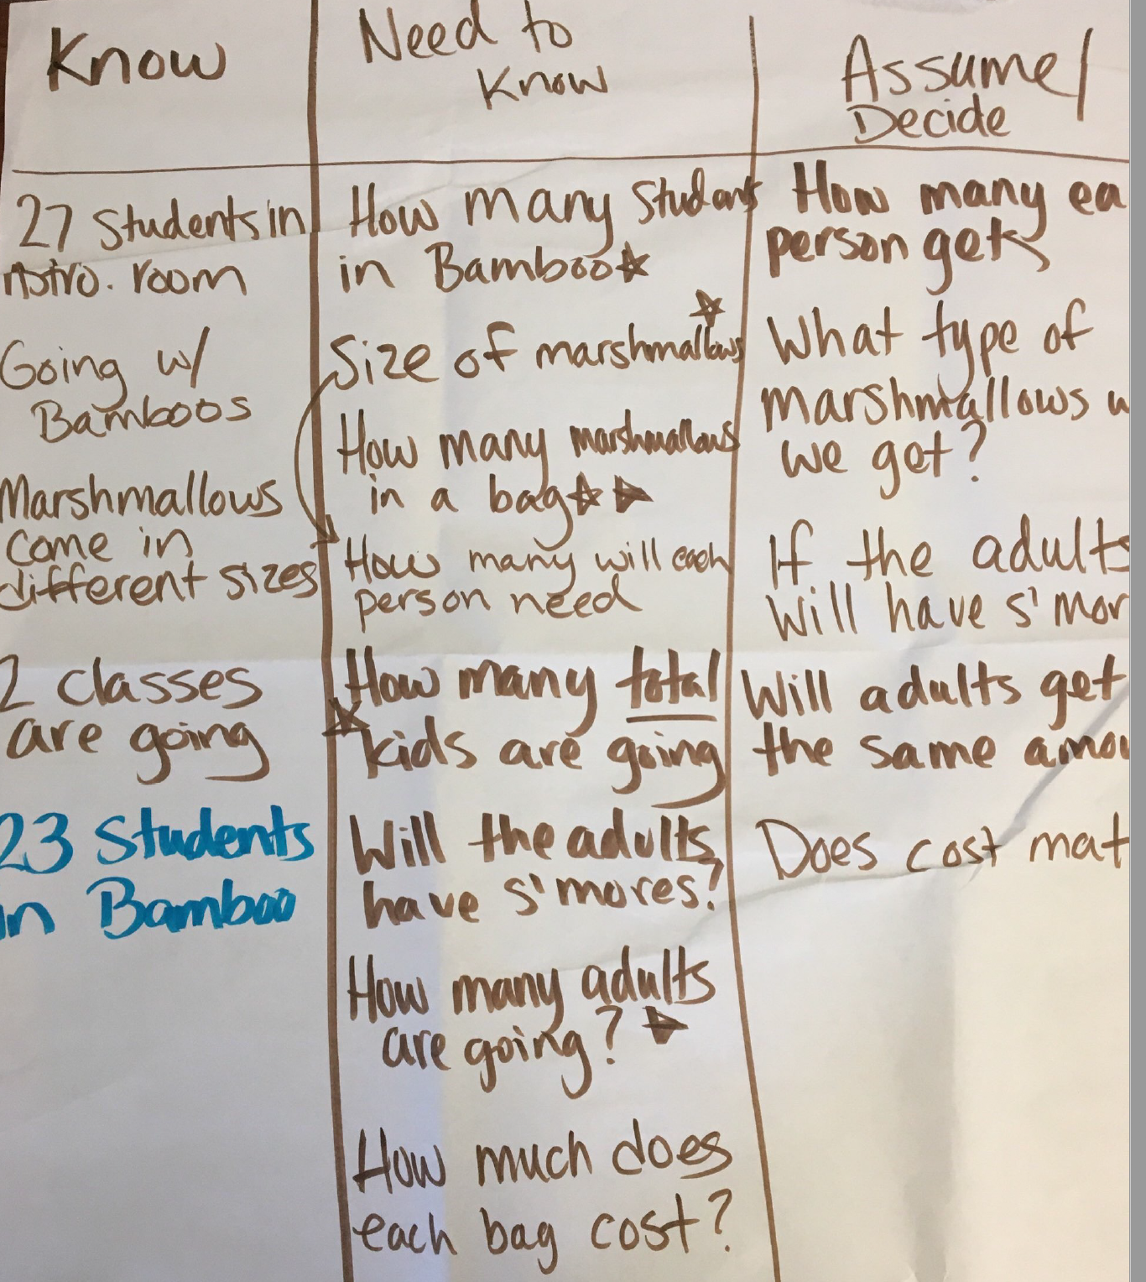
4th grade
Student Work
Students brainstorm what they know, need to know, and need to decide to solve the Marshmallow for S’Mores task.

Slide 29
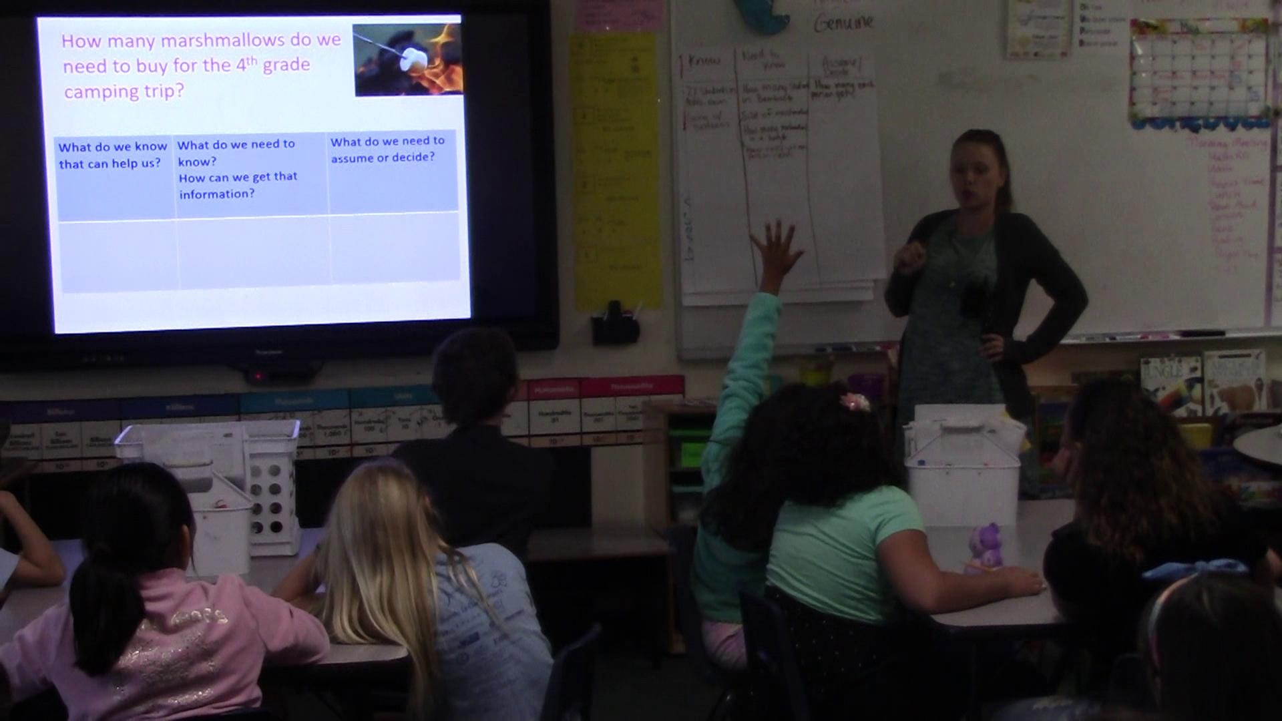

Slide 30
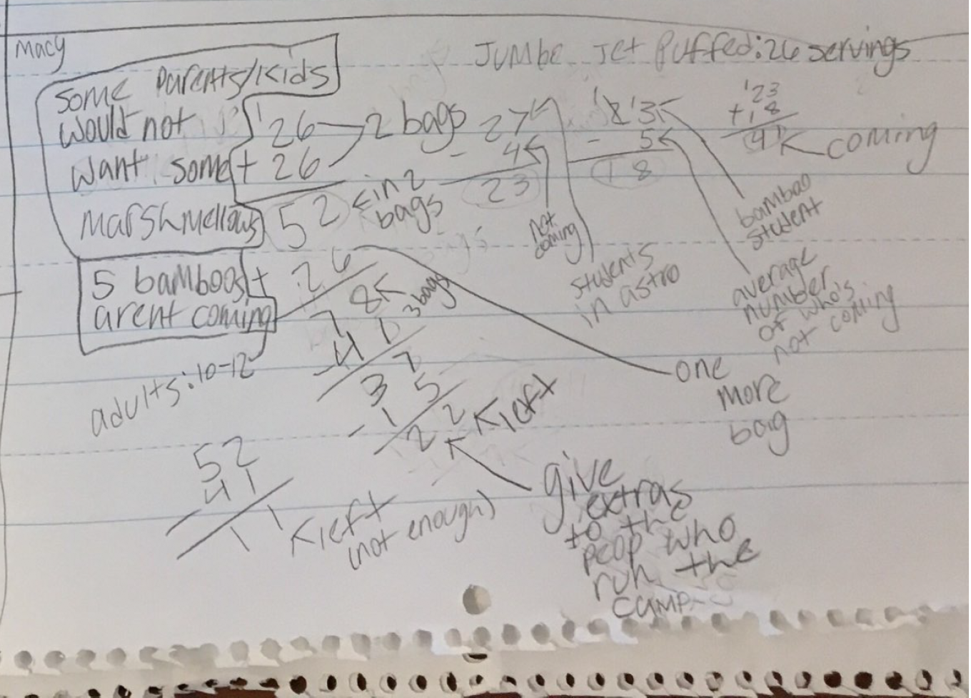
Student Work
Students assume that 41 children and 10-12 adults are coming on the trip.
They assume one jumbo marshmallow per person, and that extras are needed for the staff that run the camp.

Slide 31
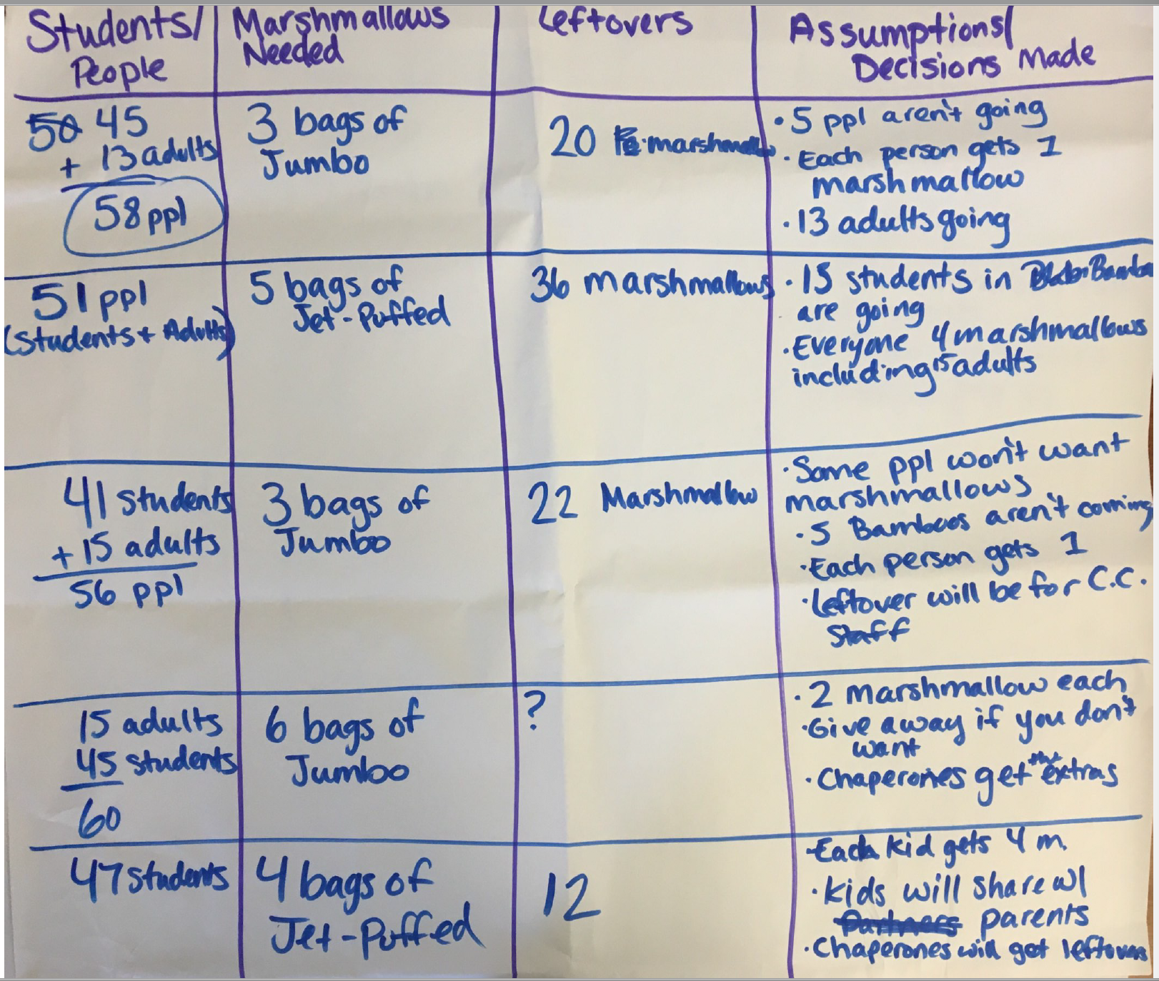
Summary of Group Solutions
Notes:
What would you want students to notice?
What would you do/ask next?

Slide 32
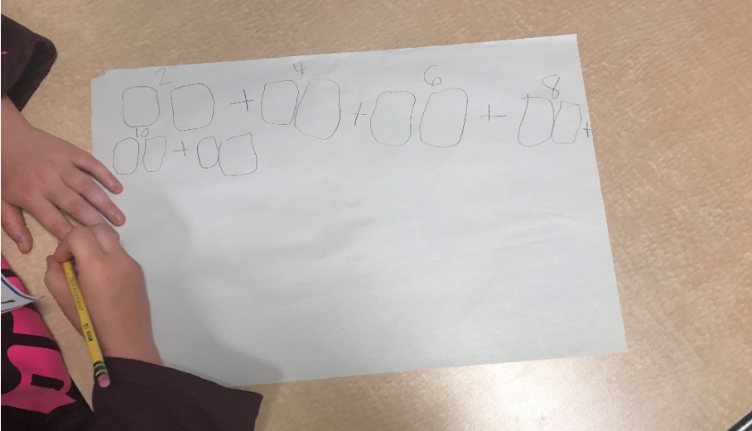
Rising 1st graders Mathematizing the Marshmallow Task
Each kid gets 2 marshmallows
McVicar (2019)
Notes:
Then we asked : what questions could be answered using mathematics? Either the kids would come up with this question, or a teacher would pose it:
how many for everyone? We asked first graders, they came up with various solutions, all of which were valid strategies.
This student:
Assumed that each kid in her work group would get 2 marshmallows.
Direct modeling her answer
Skip counting by 2s to keep track.

Slide 33
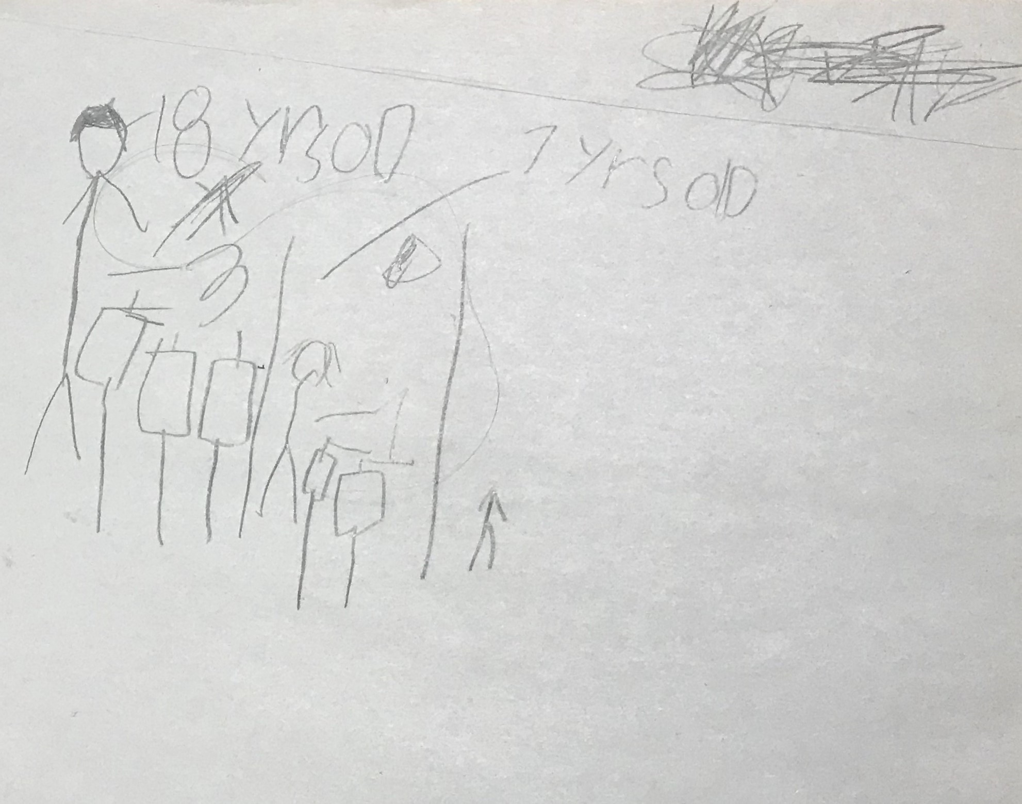
Child’s funds of knowledge:
adults get more than kids
McVicar (2019)
Notes:
This child assumed that adults get 3 marshmallows, but young children age 7 would get 2
- The child drew on their culture funds of knowledge.

Slide 34
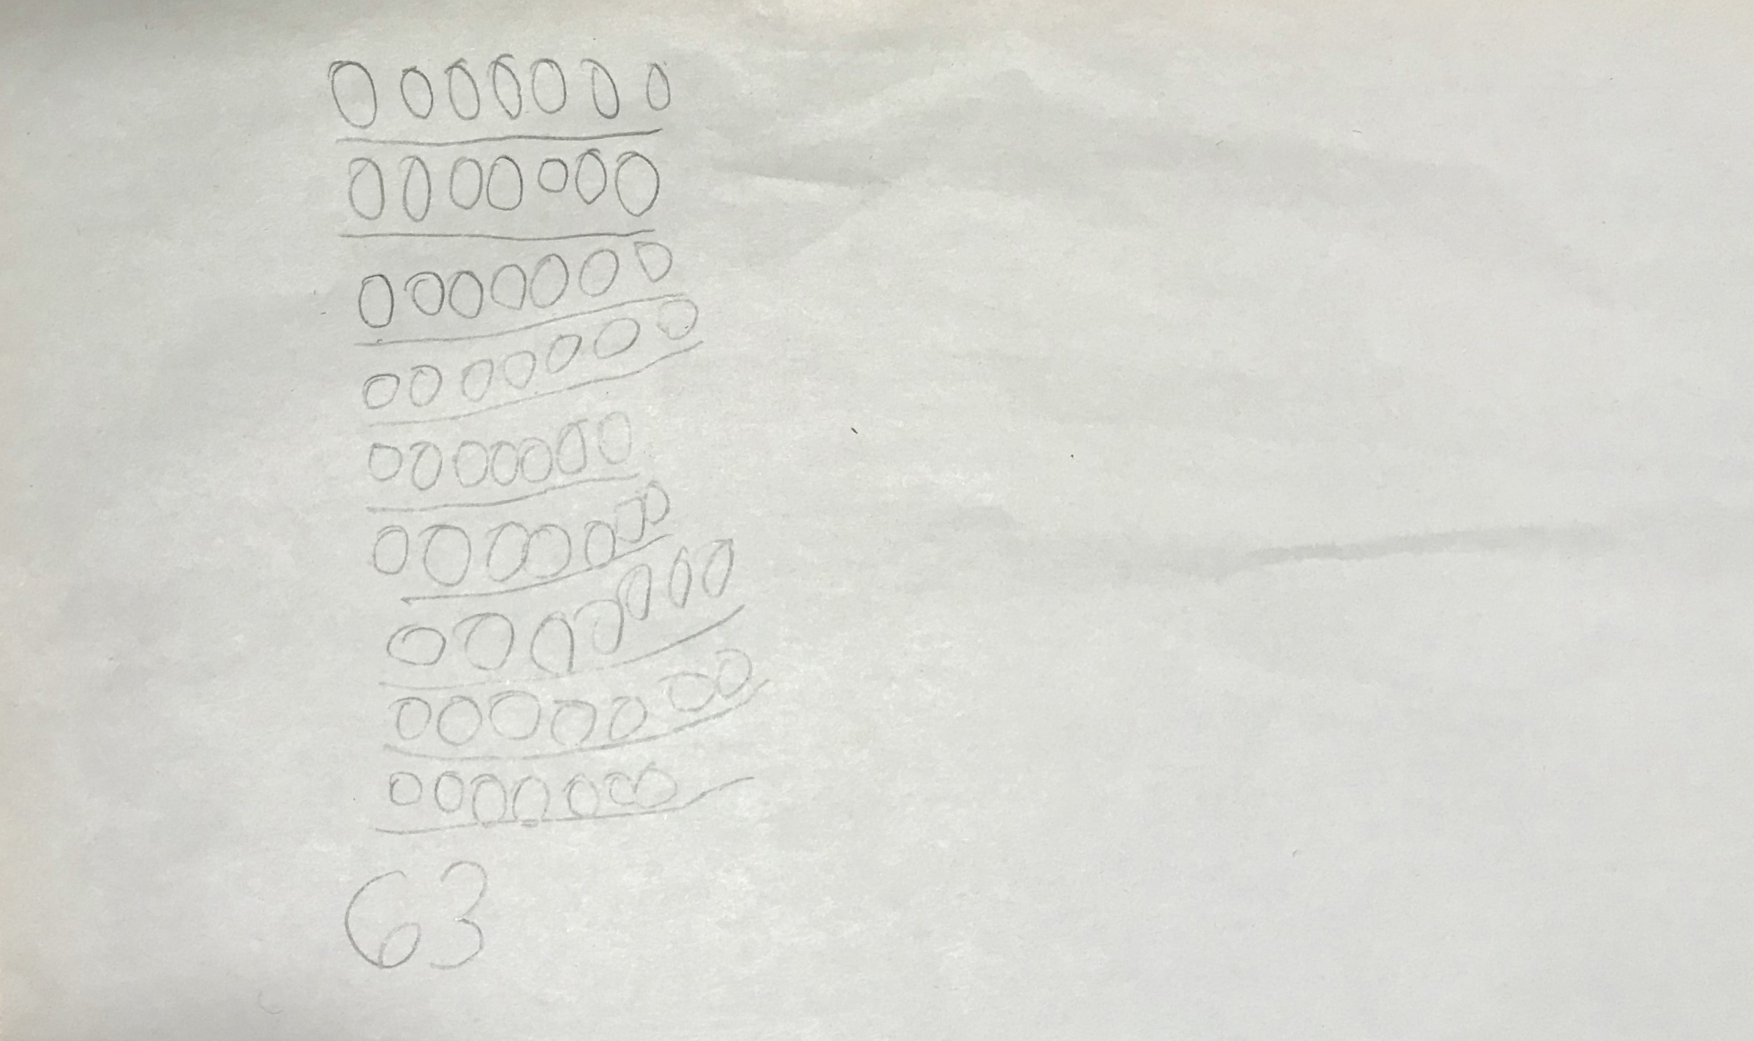
9 children
7 marshmallows each
63 marshmallows total
McVicar (2019)
Notes:
Here the assumption this child made was that every kid would get 7 marshmallows.
- This kid counted by ones to get the 63 marshmallows,
- See the foundation for equal grouping, the beginnings of multiplicative reasoning

Slide 35
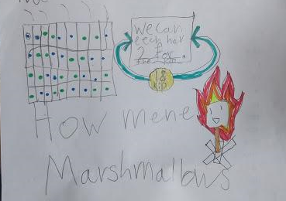
Marshmallows come in bags of 48
“We can each have 2 for the 18 kids.”
McVicar (2019)
Notes:
This first grader made an array representing 4 rows of 9
Determine that if kids get 2 marshmallows each, and there’s only 1 bag, each kid can only get 2 marshmallow
Ideas of fairness : everyone gets the same amount, if there’s only 48
Discovered was really fascinating, because it was really rich work that we might not expect 1st graders to do.
-atypical to find in math curriculums lessons on arrays and equal grouping of large quantities.

Slide 36
What is Mathematical Modeling (MM)?
An iterative process to understand real-world situations
Emphasizes communication and generalization
Is both a content (H.S.) and K-12 practice standard
Phase 1:
Make Sense of a Situation or Problem
Report Out
Phase 5:
Validate and Generalize Model
Phase 2:
Construct a Model
Mathematical Modeling Process
Phase 4:
Interpret/Analyze Solutions;
Refine Model
Phase 3:
Operate on a Model
Adapted from Anhalt, Cortez & Been Bennett (2018) and the CCSSM (2010).
(Lesh & Harel, 2003; GAIMME Report, 2019, USA)
Notes:
In our project work, we found that getting kids to talk about real world images was a great way to enter them into the world of math modeling.
From standards: Math modeling as a math practice: “Mathematically proficient students can apply the mathematics they know to solve problems arising in everyday life, society, and the workplace.” We are still learning what this looks like in the early years PreK-2.
Pt 1: It’s a cyclical, iterative process that is only used to solve real or imagined scenarios
Pt2: It’s not a simple word problem – because it involves interpreting the solution to a situation and determining if it is valid
P3: Emphasizes communication through reporting out ideas and generalizing to other situations
P4: This is a really meaty, juicy practice standard. That is often thought of at the secondary and higher ed levels. But it’s a K-12 practice standard. So our work focused on how to we give kids access to this practice standard in meaningful ways?

Slide 37
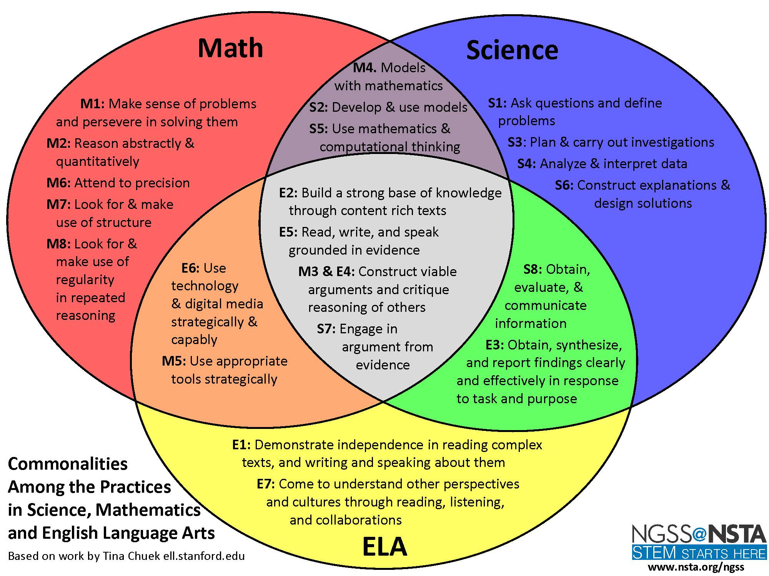
Mathematical Modeling
https://stem.hcoe.net/wp-content/uploads/Practices-Venn-Diagram.pdf
Notes:
I wanted to show you the potential that mathematical modeling has as an interdisciplinary idea.
-Bring in Math practice standards, ELA standards and Science Practices. Mathematical modeling can draw on all these areas.

Slide 38

MM is an equity lever for elementary classrooms because…
High Engagement
High Rigor
High Connection
Builds Math Stamina
Multiple entry points
Multiple solutions
Multiple strategies
Meaningful contexts
EQUITY
https://cmo.adobe.com/articles/2019/5/the-5-value-levers-for-amplifying-brand-equity.html
Notes:
Need to get to this slide by 2:45 at the LATEST -- 5 minutes for closing comments
JULIA

Slide 39
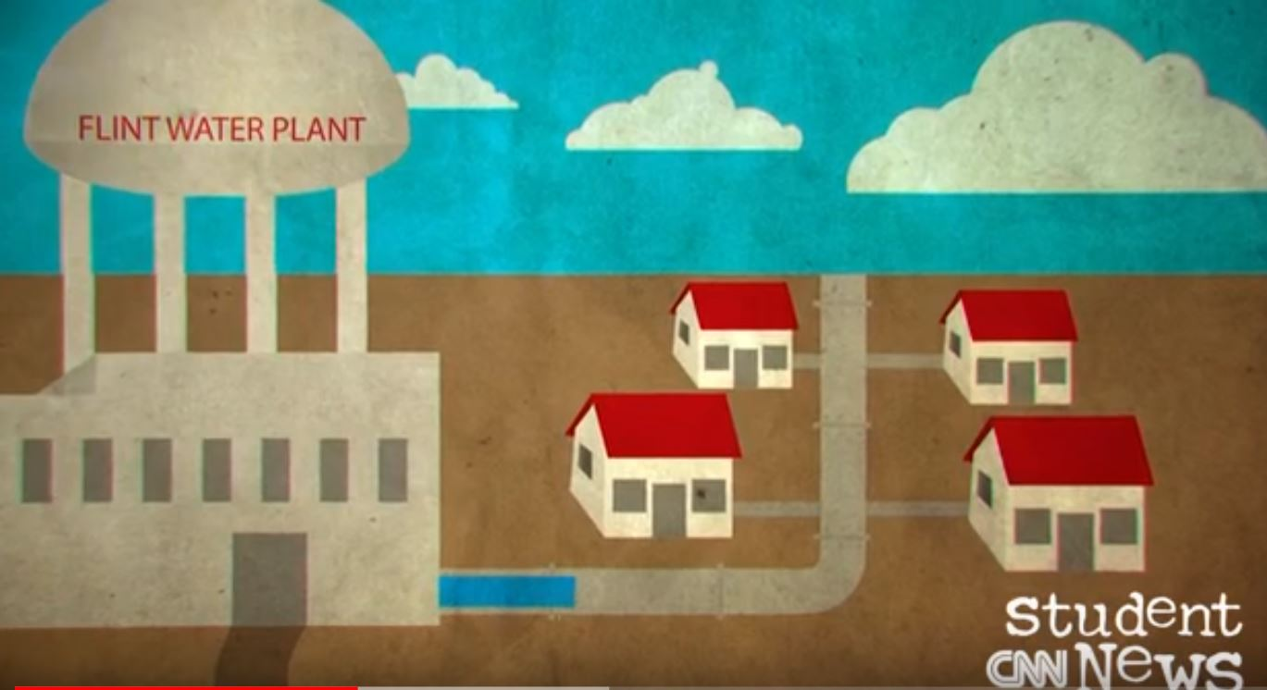
Modeling Task
SAFE WATER FOR SCHOOLS
Connections to Intermediate Grades (Grades 3-5)
https://sites.google.com/qc.cuny.edu/m2c3/home

Slide 40
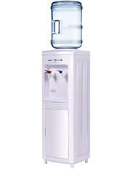
Every year, schools check the drinking water for poisonous chemicals such as lead and copper. In some schools, water fountains are not safe. Signs are posted, “do not use.” If our school water fountains were unsafe, each classroom would use a water dispenser with a large jug of water to make sure everyone has enough water to drink.
GRADE 3-5 TASK

Slide 41
If our water fountains were unsafe, how many large jugs of water would we need to make sure that everyone in our class has enough drinking water for 1 school day?
What do we KNOW that will help us? | What do we need to know or find out? | What do we need to decide? What assumptions do we need to make?
Notes:
To up the cognitive demand in the safe water task:
• change our class to our grade level or school
• change 1 school day to 1 week, 1 month, 1 year.

Slide 42
Your plan should include:
Your assumptions and decisions important to your plan
How many large jugs are needed
How you know you will have enough drinking water for everyone in our class for one school day
How others could use your plan to help their schools have enough water
Extension/challenge problem:
How many jugs of water would we need so that everyone in our class has enough drinking water for 1 week of school? 1 month of school?
Notes:
Safe water task

Slide 43
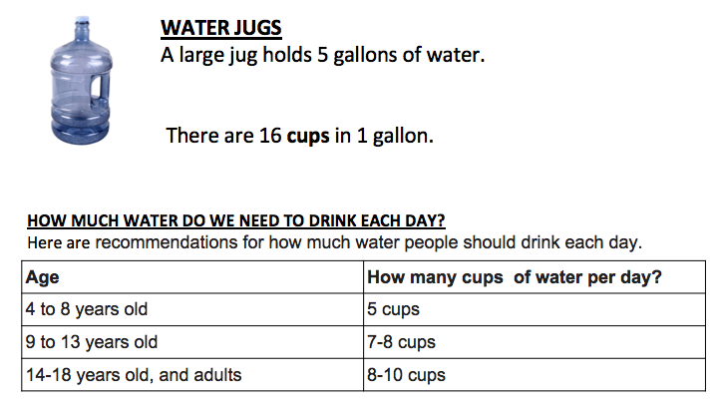
Notes:
Information that might help with assumptions and decisions

Slide 44
Important assumptions and decisions made
How many large jugs of water do we need? __________________
Use pictures, numbers, and words to show that your plan will work.
What directions would you give a student who wanted to make a plan for safe water for their class?
Notes:
graphic organizers to help students record and communicate their solutions.

Slide 45
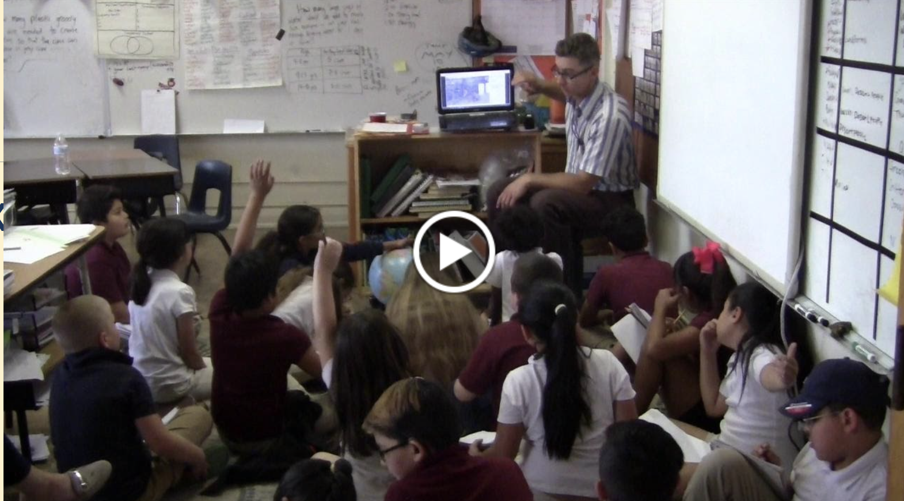
What do you notice?
What do you wonder?
What questions could you answer using math?
Notes:
Teachers often used images, such as the one we shared at the beginning of this talk, to support these conversations.

Slide 46
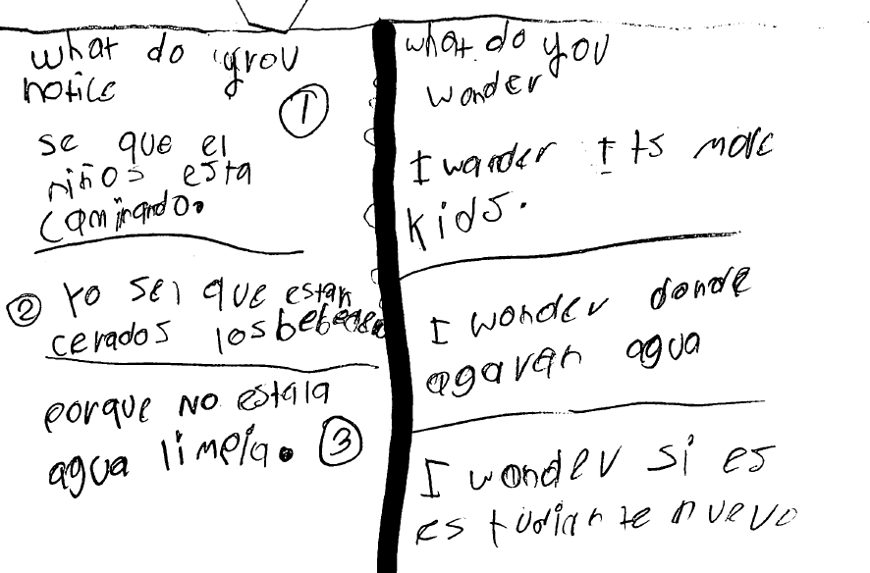
I notice that the boys are walking. I know that the water fountains are closed because the water is not clean.
I wonder if it is more kids. I wonder where they get the water. I wonder if it is a new student.
Notes:
Teachers encouraged students to communicate their ideas using the strengths and resources they brought to the classroom - this is an example of a student who recorded and shared ideas using both Spanish and English.
We found that these sense making and question posing conversations took time, but this time was essential for getting students into task….

Slide 47
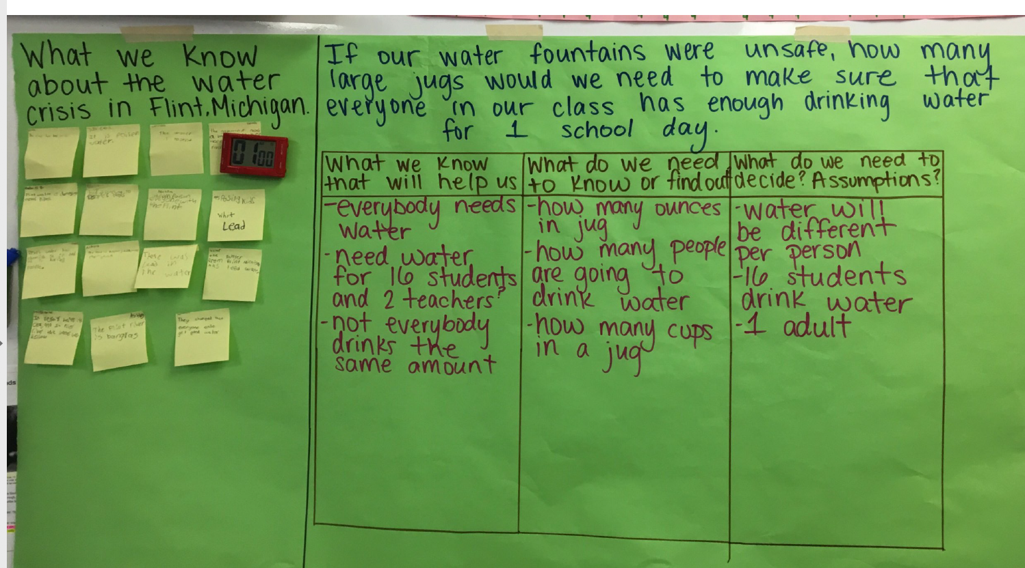
https://sites.google.com/qc.cuny.edu/m2c3/home
Turner, Aguirre, Foote, & Roth McDuffie (2019)
Notes:
Graphic organizers to record student thinking

Slide 48
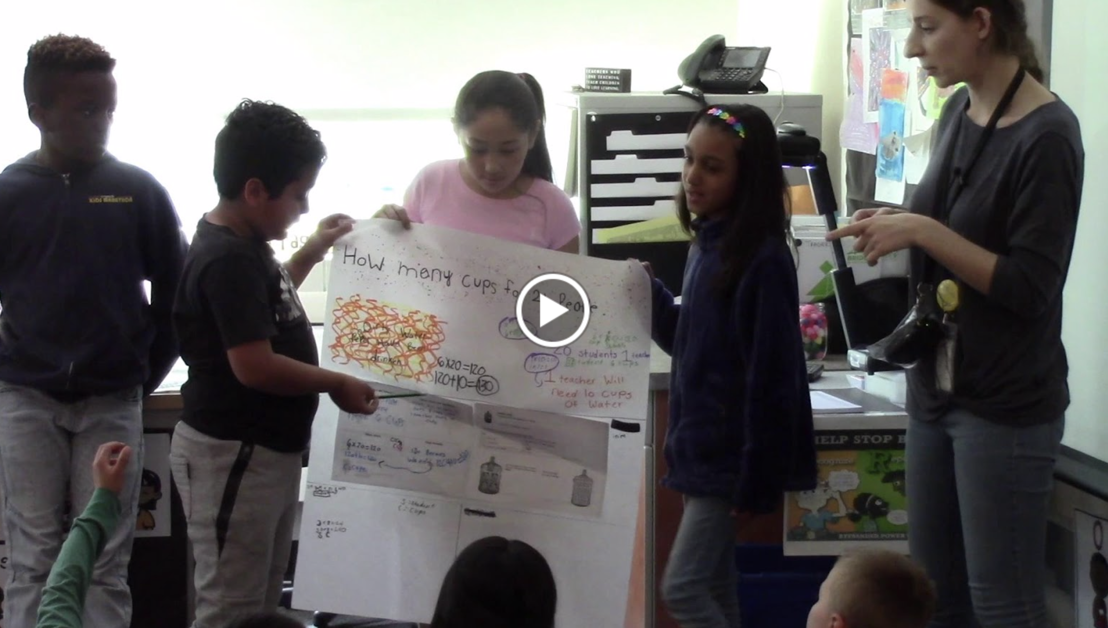
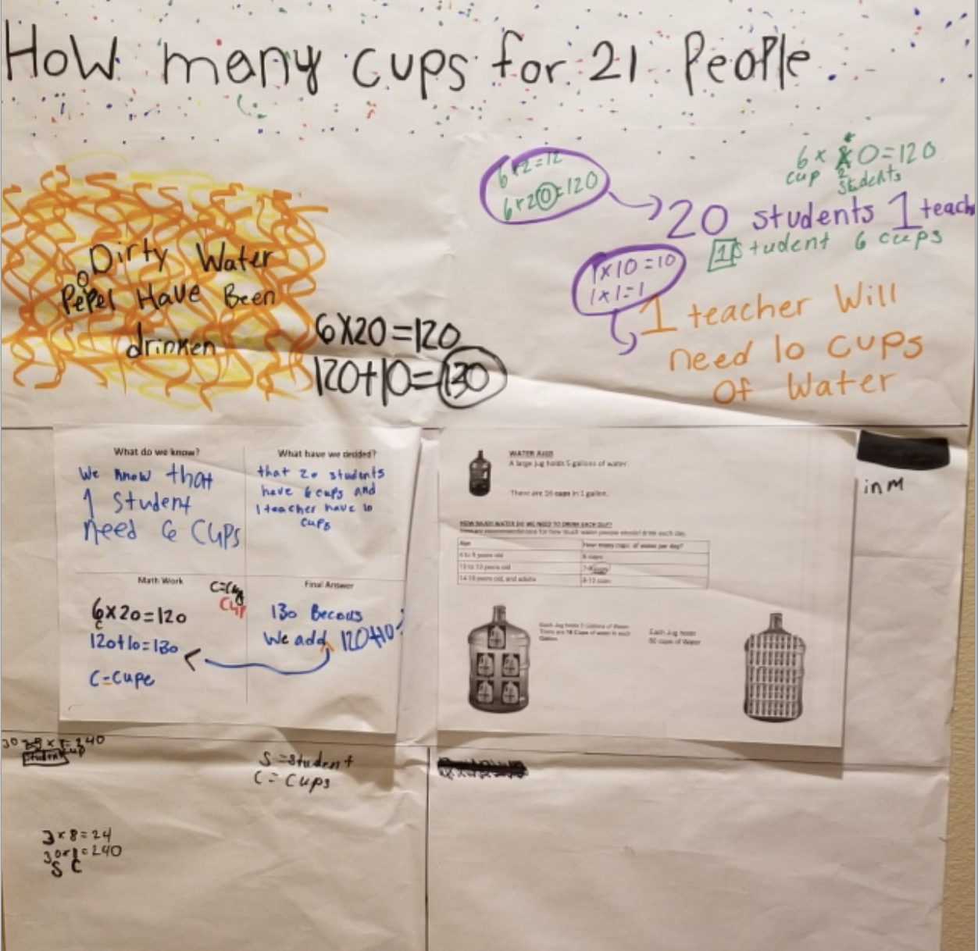
S1: First we got 6 times 20 and that equals 120. And then we added 120 plus 10 and we got 130.
T: Looks like you have a question. S2.
S2: Where did you get the 6 times 20 from?
S3: Wait, 6 times 20?
T: Yeah, where’d you get that?
S3: The 6 is for –
S1: The 6 is for cups and the 20 is for students.
T: S4, what’s your question?
S4: Where you got that 10?
T: Good question. Where’s the 10 from?
Teacher facilitates discussion.
Affirms questioning from peers,
Revoices questions to group
Invites more student discourse
S3: The 10 is from the teacher.
T: So, you’re saying there was 1 teacher you accounted for, for 10 cups? OK, tell us more.
Notes:
Transcript of teacher-student discussion during whole group report out.

Slide 49

Project Website https://sites.google.com/qc.cuny.edu/m2c3/home

Slide 50
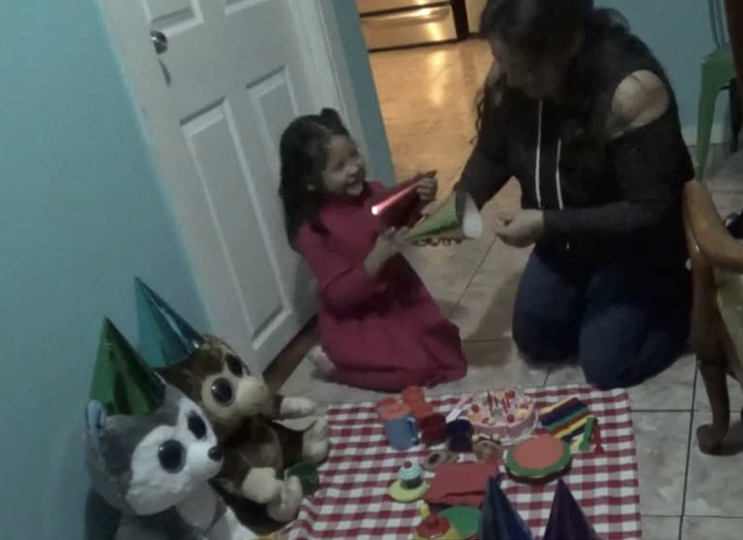
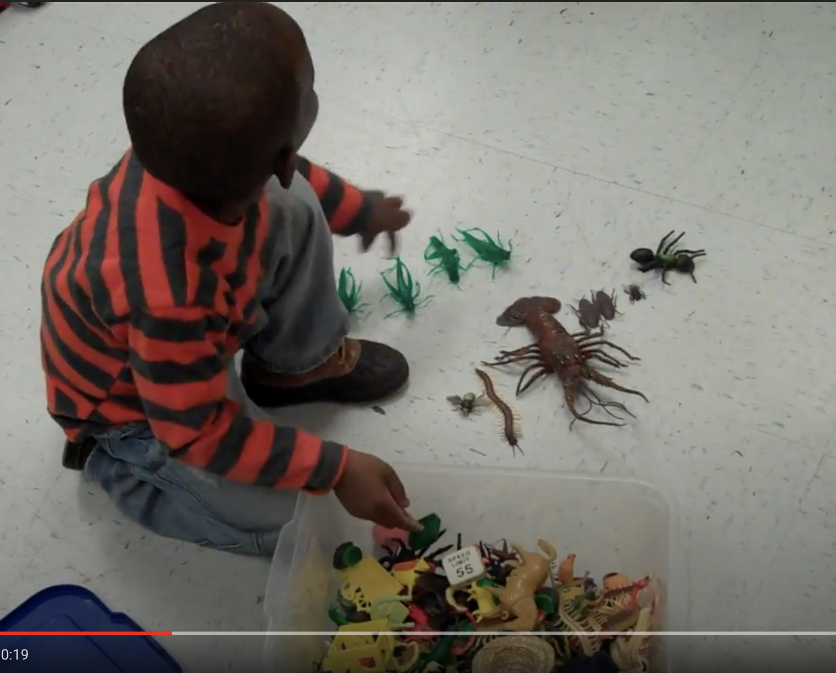
Connecting with Families about Math
Parks (2015) Exploring mathematics through play in the early childhood classroom.
http://prek-math-te.stanford.edu/overview/connecting-home-and-school-mathematics

Slide 51
Connecting with families about math
What’s worked? What’s been challenging?
Notes:
https://www.theresawills.com/templates
Type in the text box

Slide 52
Connecting with families about math
What’s worked? What’s been challenging?
Notes:
https://www.theresawills.com/templates
Type in the text box

Slide 53
What we know from research:
Family engagement with Mathematics
Positive relationship between family engagement and student achievement.
Persistent deficit labels about families and communities are barriers to children’s education
Reform mathematics often unfamiliar or inaccessible to parents
Non-dominant families (i.e. parents of Color, immigrant families) often left out of critical conversations about mathematics reform efforts
(Aguirre et al, 2013; Christensen, 2004; Civil, 2007; Civil & Bernier, 2006; Civil & Menendez, 2010; Foote, 2009; Gonzalez et al, 2001;Ishimaru et al, 2015; Jackson & Ramiliard, 2005; )

Slide 54
What we know from research:
Family engagement with Mathematics
Families are intellectual resources for mathematics teaching and learning
Teachers can leverage these intellectual resources to support rich, rigorous and relevant mathematics for students.
(Aguirre et al, 2013; Christensen, 2004; Civil, 2007; Civil & Bernier, 2006; Civil & Menendez, 2010; Foote, 2009; Gonzalez et al, 2001;Ishimaru et al, 2015; Jackson & Ramiliard, 2005; )

Slide 55
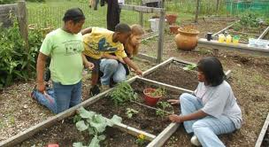

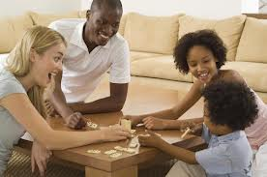
Cultural Funds of Knowledge
People have and produce math knowledge outside of school tied to specific cultural/family/community practices (e.g. home repair, banking, games, cooking, shopping, sports, sewing, party-planning, painting, gardening, budgeting, music, dance etc.)
Civil 2007; Civil & Khan, 2001; Gonzalez et al, 2005; Jackson & Ramillard, 2005; Nasir, 2007

Slide 56
How do you gain access to family/community knowledge?
Be curious: Design student and family surveys/interviews ask what they like/not like about their neighborhood; ask about their family activities outside of school; things they do with friends; hobbies, career aspirations etc.
Listen actively: for opportunities to mathematize situations and stories from kids, families, communities – special events
Prioritize Play: Use formal and informal experiences in play, curriculum and teaching to strengthen children’s problem-solving and reasoning processes.
Encourage math talk: create opportunities for students to explain their thinking while interacting with math ideas (e.g. different algorithms, procedures etc.)

Slide 57
How do you gain access to family/community knowledge?
Examine textbooks from other countries (e.g. request from consulates; community organizations)
Take a COMMUNITY MATH WALK in your students’ communities and neighborhoods - talk to merchants, community leaders, families in those places. Observe math practices happening.
Create community-based assignments (POW, POD, research projects) that necessitate the connection: community inquiries, math conversations with families, current events (e.g. voting patterns, mortgages, gas prices, immigration policies, water quality, environmental protection, safety)

Slide 58
Communicate your vision
Newsletters & Websites

Slide 59
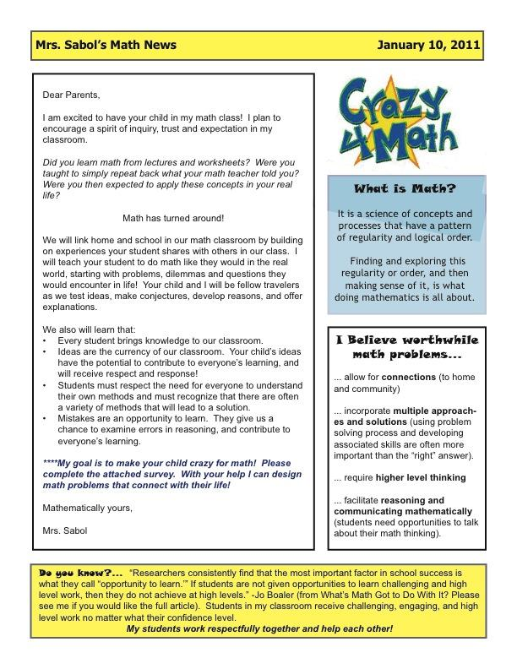
Personal Letter to parents
Definition of math
Math learning expectations
Worthwhile math
Family survey request
Connection to research
Aguirre, Mayfield Ingram & Martin (2013)

Slide 60
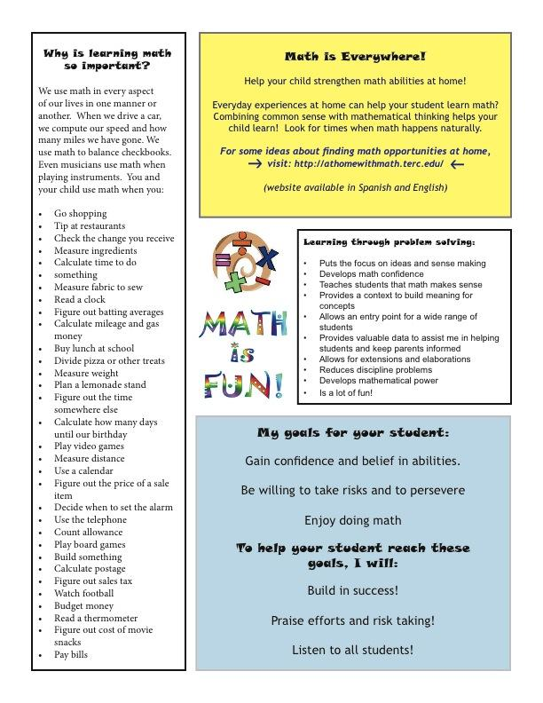
Bilingual Internet Resources
Family math examples
Emphasize problem solving
Math learning goals
Aguirre, Mayfield Ingram & Martin (2013)

Slide 61
Design-related questions for math newsletters & Websites
Aguirre, Mayfield Ingram, & Martin (2013)
What is mathematics, and why is it important to learn?
What are our goals for students as math learners?
What does mathematics learning look like in your class?
What does mathematics teaching look like in your class?
How will you engage parents and community in developing mathematics learning in your classroom?
How will you help students with different math preparation and levels of confidence succeed?
How will you help students of various ethnic, cultural and socio-economic backgrounds – some of which are learning a second language – thrive in your mathematics class?
Notes:
Key Features of the Newsletters – Crazy 4 math

Slide 62
Strategies that support Math learning for Multilingual Students
RECAP
Provide relevant contexts**: Connect math to student’s life experiences and cultural & community-based funds of knowledge
Create language rich environment: visual posters of student work, reference charts
Establish communication norms: Students explain, justify, summarize, question and share solutions
Adapted from Anhalt (2014)

Slide 63
I want to try….
Mathematizing World Routine
Modeling Task
Create a math newsletter
Give a family survey
Notes:
Place a star next to the activities you would like to try with your students this year

Slide 64
Culturally responsive teachers have unequivocal faith in the human dignity and intellectual capabilities of their students.
Geneva Gay (2000)
THANK YOU
Julia Aguirre
University of Washington Tacoma
jaguirre@uw.edu
Website:

